Slide 1


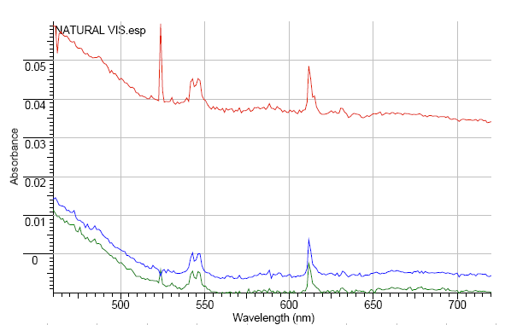
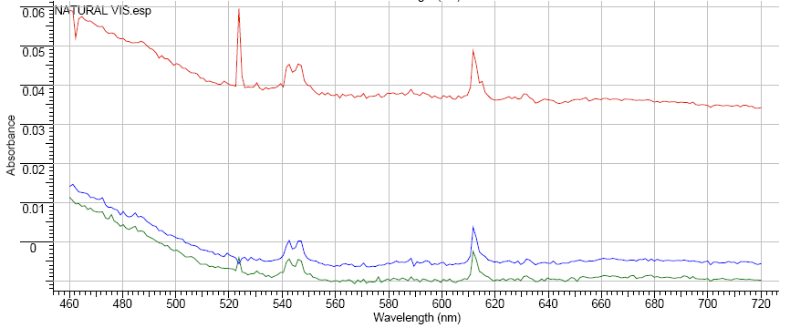

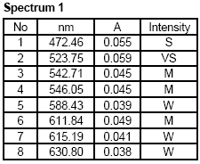
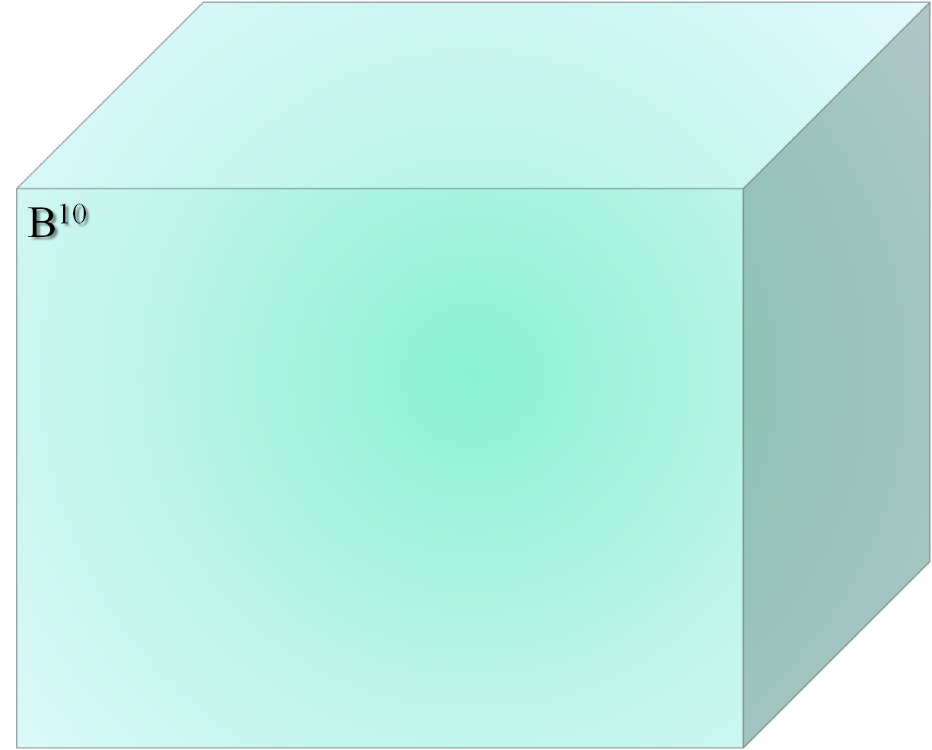

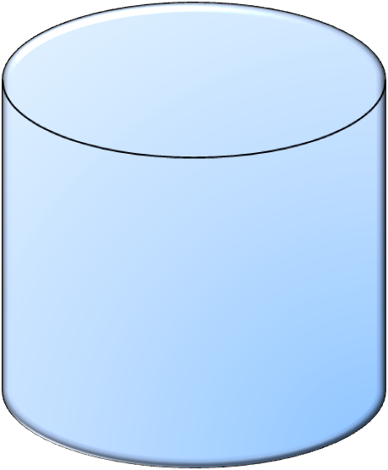


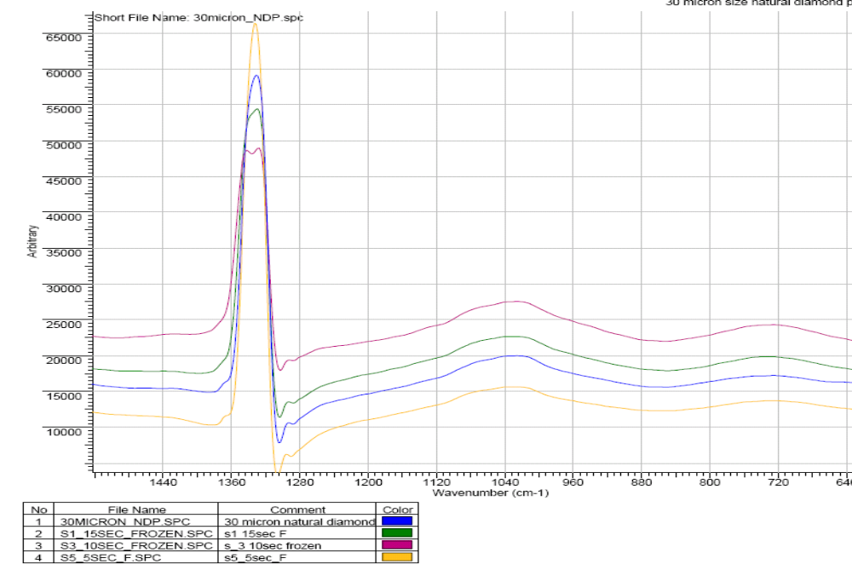
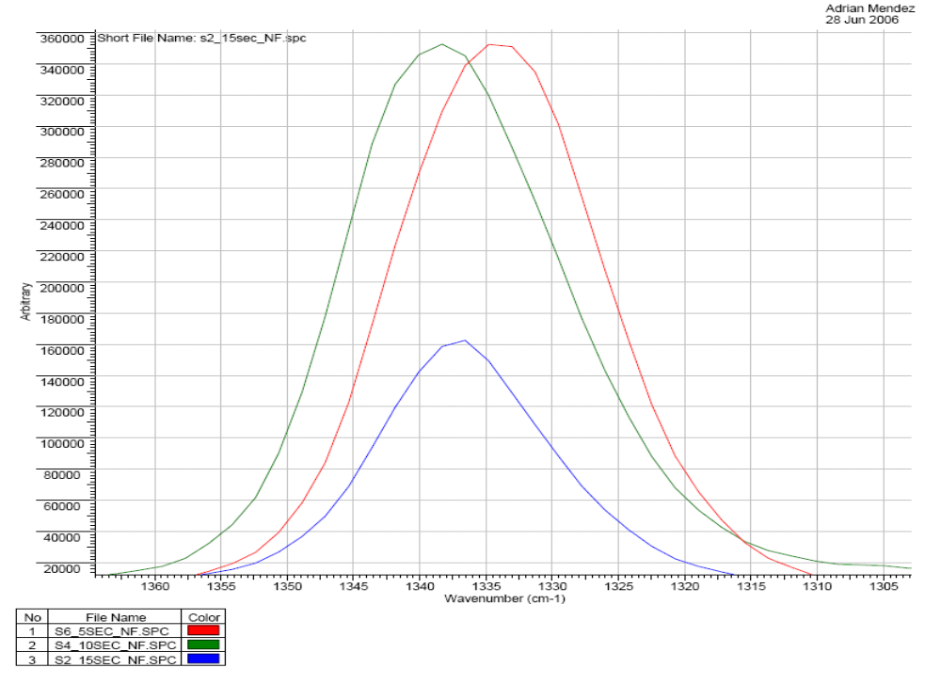
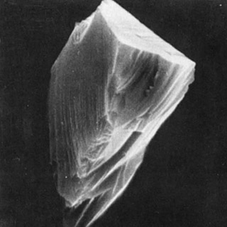

Study of fast-neutron irradiation in diamond, uses radiation in materials
Adrián Mendez, Jennis M. Vicente, Dr. Mark Prelas, Dr. Tushar Ghosh
University of Missouri-Columbia, Nuclear Science and Engineering Institute
Why fast _{o}n¹ in crystals?
Controlled way to modify the structure of diamond by.
Creation of point defects
Submicron structures
Can increase in the diffusivity of impurities, absorption
Can increase in the surface area by creation of pathways by the fast _{o}n¹
To study the use of fast neutron as a controlled mechanism to introduce controlled defects on the crystal structure.
To characterize the effect of fast neutron irradiation in the optical properties of diamond.
The necessity of new materials that can tolerate the operational conditions of the new generation nuclear reactors.
The necessity of materials that can accelerate the development of the proposed Nuclear based Hydrogen production cycle.
HEADING – UV-VIS Spectra of untreated and treated samples at different fluence
Applications
High temperature – Irradiation tough material for the new generation, high temperature, nuclear reactor
Microencapsulation of radioactive and non radioactive material, such as H³ and H²
Ceramic window with high power transmission with good thermal conductivity, a milestone in the development of a 170 Ghz, 1 MW continuous wave gyrators for Electron Resonance Heating (ECH)
Diamond and diamond-like carbon (DLC) are promising materials with a wide variety of applications as X-ray windows, wear resistant coatings, high energy sensors, and semiconductors applications that can tolerate extreme environments.
Diamond properties, such as resistance to radiation, make it a desirable in areas where the material is exposed to high radiation fields.
Irradiation of high energy particles can damage traditional materials affecting the mechanical and electrical properties.
Certain desired properties can be achieved by the irradiation process and by the creation of point defects and submicron structures in the crystal in a controlled form with minimal degrading.
n +B
Natural
Diamond
Absorption cross section of _{O}n¹_{t} @ 2200 m/s :
B¹⁰ 3835 Barn
Diamond .00350 Barn
The samples exhibited a high-quality Raman spectrum with the 1332 cm⁻¹
Shorter irradiation time seems to increase the quality of SP3 bonded carbon
Absorption spectra in both Vis and UV range where decreased as a function of the fluence.
Nitrogen centers are been modified by the irradiation.
No sign of graphite or other carbon allotropes were identified
Two 1 gram of natural diamond particles (30-40 micron meter size) were irradiated with fast neutrons (6.5 x 10¹² (fast) neutrons/cm2) for 5 and 15 seconds at the Missouri Research Reactor MURR
During irradiation samples were isolated from thermal energies neutron using a thermal-neutron trap consisting B10 surrounding sample. The samples were irradiated at room temperatures
Properties of micron size diamond powder
Chemical Composition | Carbon
Density | 3.515 g/cm^3
Crystal structure | Cubis Face-Centered
Bandgap energy | 5.49 eV
Resistivity | > 10¹² Ohms cm
Breakdown Voltage | 107 V/cm
Electron Mobility | 2400 cm^2/ V s
Major Impurities | Nitrogen
Hole mobility | 2100 cm^2/V s
Saturation Velocity | 220 km/s
Dielectric constant | 5.7
Energy to form e-h pair | 13 eV
Chemical Resistance | Not affected by any acid
Thermal Conductivity | 2000 W/mK
NAT diamond has a monocrystalline particle structure, reated by high pressures and temperatures underground. Like synthetic monocrystalline diamond, it features major cleavage planes, which are oriented parallel to the optical axis. Natural diamond particles break relatively easy parallel to the cleavage planes. NAT diamond is precision graded and has a blocky, sharp-edged particle shape. It is free of catalyst metals, which makes it the preferred choice for plated tools and other applications requiring maximum cleanliness. Natural diamond is also used in lapping and polishing processes with special requirements.
Diamond Sp³ bonded- carbon structure was studied using Micro-Raman Spectroscopy. Optical defects and absorption characterized with UV-Vis Spectroscopy
Further analysis including radioisotopes identification, FTIR, XPS and SEM/EDS are going to be made to the irradiated sample to identify any impurities and defectcts on the crystal.
Absorption properties of fast neutron irradiated diamond are going to be studied.
D.P. White “Thermal Conductivity of Natural and Isotopically Enriched Diamond” Dept of Physics, Merrimack College, N. Andover, MA
F. Blum “Sensor Based on CVD Diamond”
SEM (SE) micrograph of the diamond powder
HEADING – RAMAN Spectra of untreated and treated samples at different fluence
Acknowledgement
Nuclear Science and Engineering Institute for their support in this investigation

